Slide 2
Nasir Uddin Ahmed
Id – 011 151 086

Slide 3
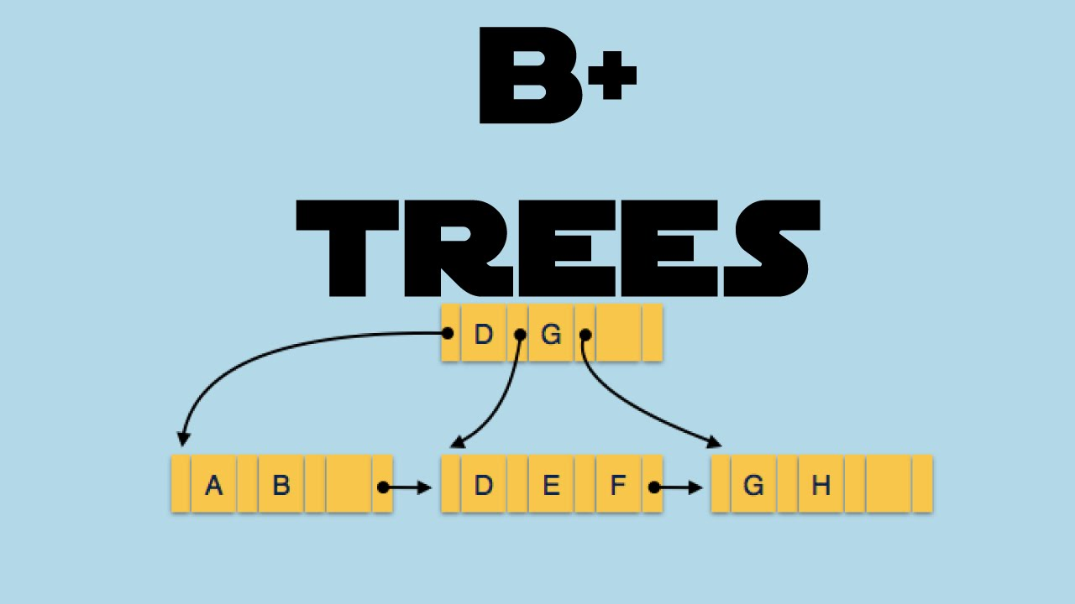

Slide 4
INDEX
Introduction
Overview
Searching
Insertion
Deletion
B+ Tree Vs B Tree
Advantages

Slide 5
INTRODUCTION
B+ tree is a balanced tree
Path between the root to a leaf is of same length
Data is stored in the leaf nodes
Every leaf is at the same level
A B+ tree grows upwards
Sibling pointers allow sequential searching

Slide 6
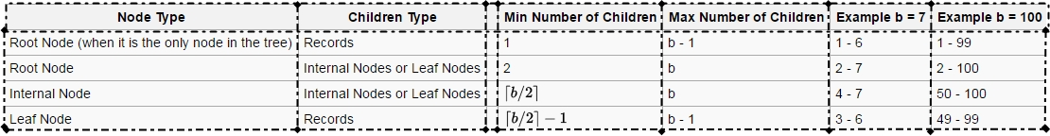
B+ TREE [Overview]

Slide 7
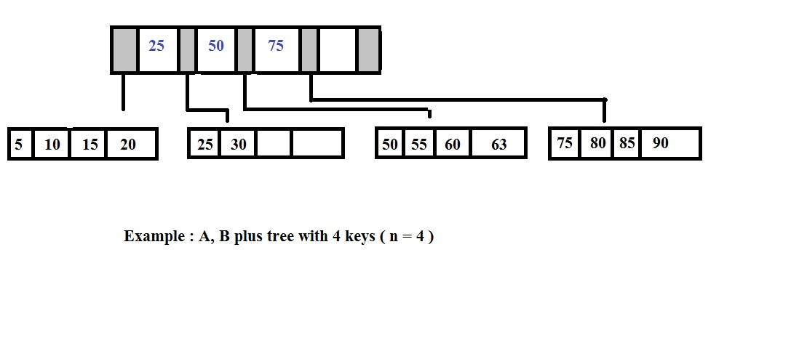
B+ TREE

Slide 8
B+ TREE

Slide 9
B+ TREE [Searching]

Slide 10
B+ TREE [Inserting]
Three cases can occur
Space in the leaf node
No space in the leaf node
Inserting the same element

Slide 11
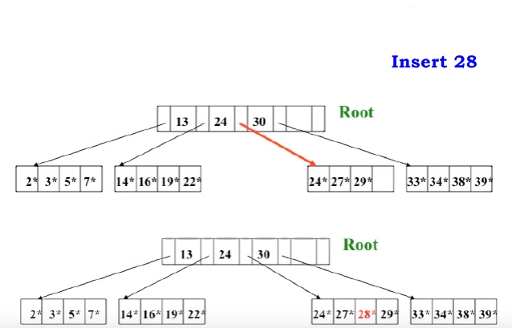
B+ TREE [Inserting]

Slide 12
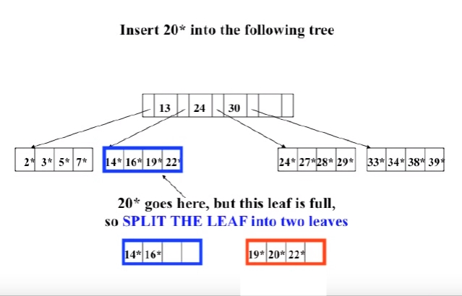
B+ TREE [Inserting]

Slide 13
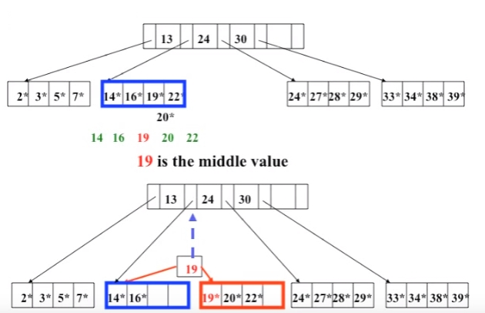
B+ TREE [Inserting]

Slide 14
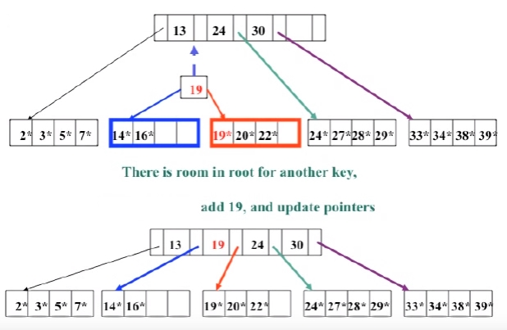
B+ TREE [Inserting]

Slide 15
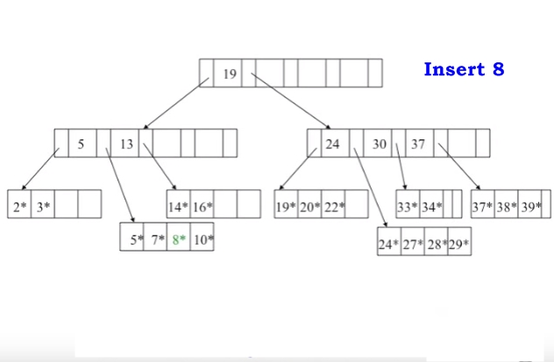
B+ TREE [Inserting]

Slide 16
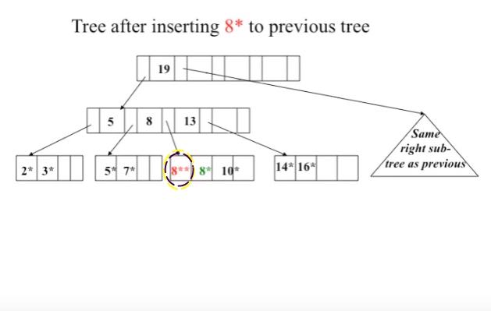
B+ TREE [Inserting]

Slide 17
B+ TREE [Deleting]
Two cases can occur
Deleting the leaf node
Deleting the root leaf

Slide 18
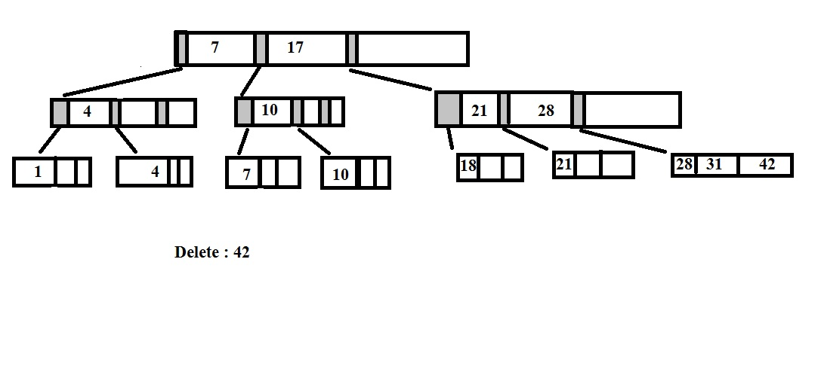
B+ TREE [Deleting]

Slide 19
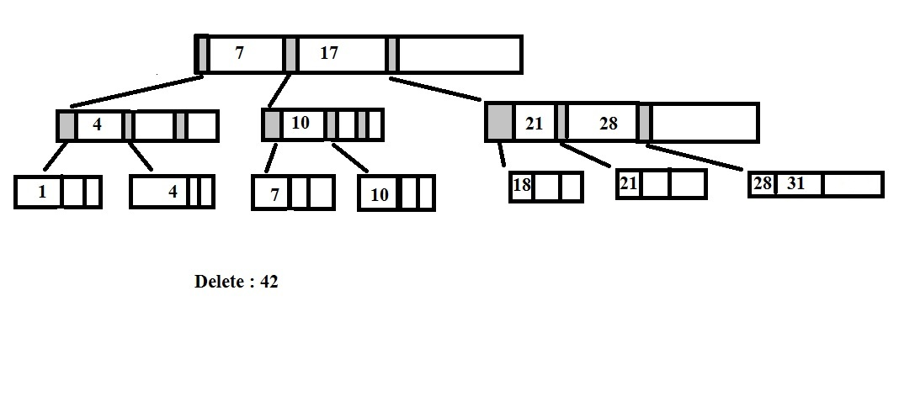
B+ TREE [Deleting]

Slide 20
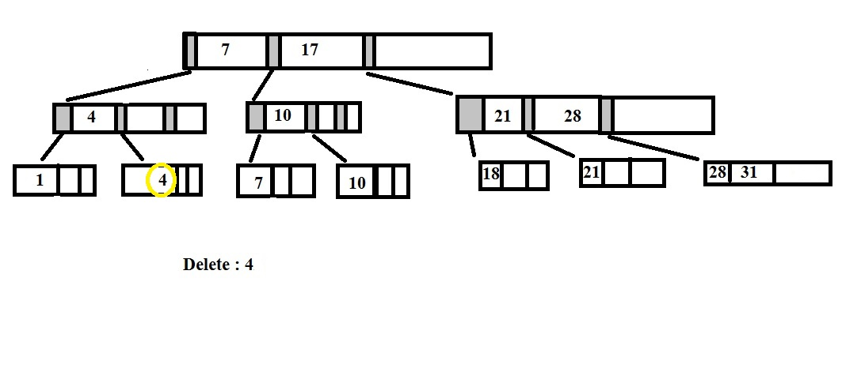
B+ TREE [Deleting]

Slide 21
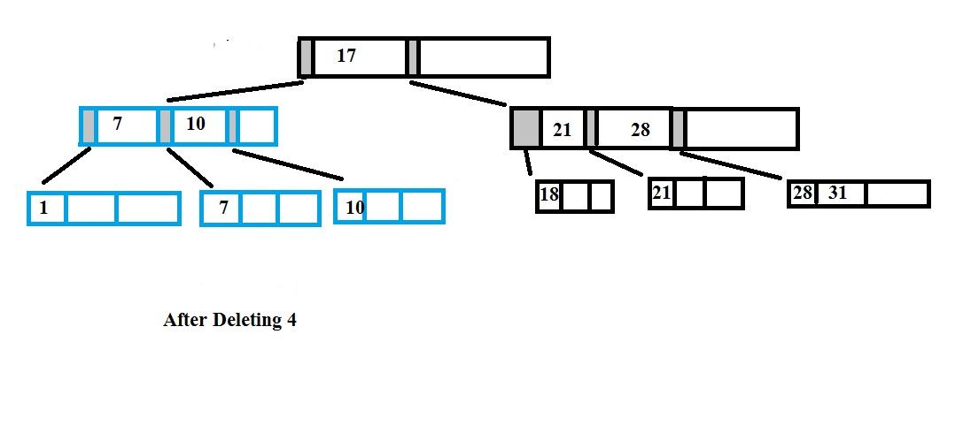
B+ TREE [Deleting]

Slide 22
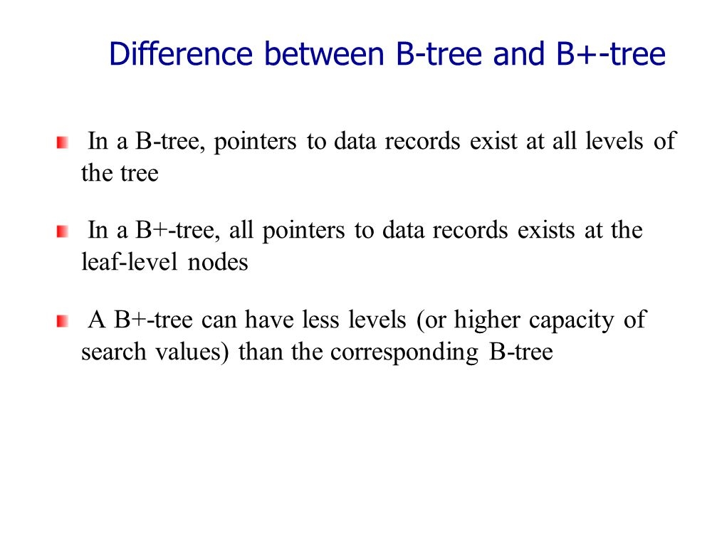
B+ TREE [B+ Tree Vs B Tree]

Slide 23
B+ TREE [Advantages]
For sorting directories
The leaf nodes of B+ trees are linked, so doing a full scan of all objects in a tree requires just one linear pass through all the leaf nodes.
Separates key from data
Space efficiency of B+ trees can be improved by using some compression techniques

Slide 24

Any Question

Slide 25


